Slide 1
AI Employee Prototype for Data Analysis
Automating Data Insights with Machine Learning and Reporting
Avantika Bisht

Slide 2
Introduction to AI Employee Prototype
What is it?
The AI Employee Prototype automates data analysis and report generation.
It processes raw datasets, applies machine learning algorithms, and outputs a PDF report with insights.
Key Features:
Data Preprocessing: Cleans and prepares the dataset.
Analysis Engine: Performs PCA, K-Means Clustering, and Linear Regression.
Report Generation: Generates a detailed PDF report with charts and summaries.

Slide 3
How the AI Employee Works
Data Flow:
Data Preprocessing: Handles missing values, scales numeric columns, encodes categorical data.
Analysis Engine: Applies statistical and machine learning algorithms (PCA, K-Means, Regression).
Report Generation: Produces a PDF report with visualizations like scatter plots and clusters.
User Interaction:
The system is controlled through a Command-Line Interface (CLI).

Slide 4
Demo of AI Employee Prototype
How to Run:
The system is operated via a simple CLI.
Commands:
run analysis: Runs the data analysis.
generate report: Produces the PDF report.
Live Demo:
Step 1: Start the CLI with the command: python cli.py.
Step 2: Run the analysis by typing run analysis.
Step 3: Generate the PDF report by typing generate report.

Slide 5
Analysis Techniques Implemented
Principal Component Analysis (PCA):
Reduces the dimensionality of the dataset while preserving important variance.
Helps visualize complex data in 2D space.
K-Means Clustering:
Groups data points into clusters based on similarity.
In this case, it can group countries by their medal performance.
Linear Regression:
Predicts relationships between features, such as the impact of Gold, Silver, and Bronze medals on the total count.

Slide 6
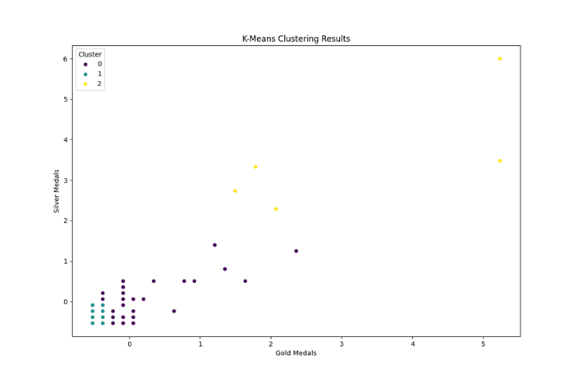

Slide 7
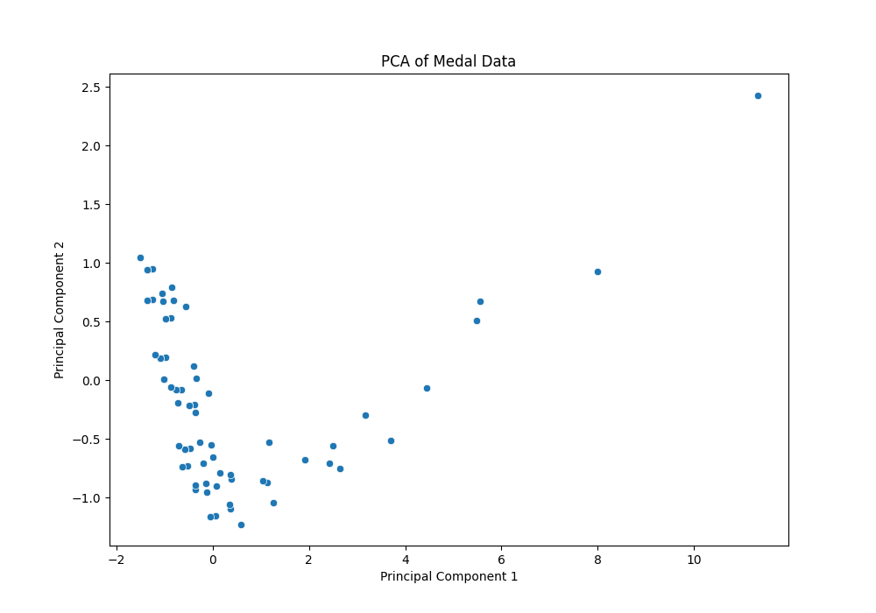

Slide 8
Challenges and Potential Improvements
Challenges:
Handling various dataset formats and missing data.
Properly managing report layout to avoid overlapping plots.
Potential Improvements:
Expand analysis techniques (e.g., Neural Networks, Decision Trees).
Develop a Graphical User Interface (GUI) for easier interaction.
Support larger datasets and dynamic file formats (e.g., Excel, JSON).

Slide 9
Conclusion
Summary:
The AI Employee Prototype successfully automates data analysis and generates PDF reports.
It simplifies data preprocessing, applies machine learning algorithms, and provides insights in a user-friendly format.
Future Potential:
With more advanced techniques and a better UI, the AI employee could serve as a versatile tool for businesses.

